Slide 1
Annual Presentation to Regional Councils
Christina Conti
Washoe County Health District

Slide 2
EMS Oversight Program
EMS Oversight Program Manager – Christina Conti
EMS Coordinator – Brittany Dayton
Statistician – Heather Kerwin
Office Support Specialist – Jackie Lawson
EMS Advisory Board Support – Dawn Spinola

Slide 3
Inter-Local Agreement
August 2014 – Inter-Local Agreement (ILA) for EMS Oversight adopted by political jurisdictions.
The agreement created a regional EMS oversight function within the WCHD for the management, measurement and improvement of EMS.
Compliance vs. performance
Expansion of data collection and reporting

Slide 4
Authority of ILA
District Board of Health (DBOH)
Inter Local Agreement for EMS Oversight:
Established EMS Advisory Board
Established Regional EMS Oversight Program
Defined duties of EMS Oversight Program
Defined duties of signatories
Signatories include: City of Reno, City of Sparks, Truckee Meadows Fire Protection District, Washoe County Board of County Commissioners, and Washoe County Health District

Slide 5
EMS Advisory Board
EMS Advisory Board is comprised of the following members:
Reno City Manager
Sparks City Manager
Washoe County Manager
District Health Officer
Emergency Room Physician – (DBOH Appointment)
Hospital Continuous Quality Improvement (CQI) Representative –(DBOH appointment)

Slide 6
EMS Advisory Board
The EMS Advisory Board was established to provide concurrent review of present topics within the Washoe County EMS System.
The EMS Advisory Board meets quarterly and reviews reports, evaluations, and recommendations of the EMS Oversight Program.
Makes recommendations to District Health Officer and/or the DBOH related to performance standards, medical protocols, etc.
Strives to implement recommendations of the EMS Oversight Program.
Makes recommendations to respective Boards/Councils regarding participation in working groups established for coordination, review, evaluation and continuous improvement of Emergency Medical Services.

Slide 7
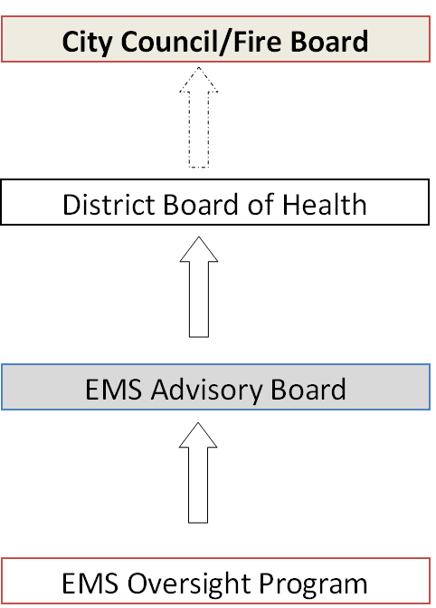
Organizational Chart

Slide 8
FY 2017-2018 Annual Report
FY19 Annual Report will be published in November

Slide 9
Data Report Highlights

Slide 10
Data Report Highlights
52,117 calls for service.
Matched calls between fire agencies and REMSA.
1.01% increase from FY16-17
Median Response Travel Times:
En Route Fire First Responder arrival: 04:19 minutes
En Route REMSA arrival: 05:52 minutes
Patient Perspective:
Median time a patient is waiting from the initial call to the first arriving unit on scene, utilizing REMSA priorities.
REMSA Priority | Patient's Perspective
1 | 05:52
2 | 06:25
3 | 07:13
9 | 07:51
All | 06:14
Used N = 50,680

Slide 11
Data Report Highlights

Slide 12
Regional Accomplishments
EMS Strategic Planning Initiatives Accomplished:
Implementation of appropriate protocols to determine service levels through EMD process to low acuity Priority 3 calls.
Omega calls implemented February 1, 2018
Card 33 calls implemented July 2, 2018
Alpha calls implemented October 1, 2018
Develop a regional set of protocols for the delivery of prehospital patient care.
January 2018 protocols were in effective for eight agencies within Washoe County.

Slide 13
Regional Accomplishments
Statewide training developed for First Responders
Videos provide basic information about a variety of disabilities and strategies to use when responding to calls involving citizens with intellectual and/or development disabilities.
Mass Casualty Incident Plan Update, Alpha Plan
The EMS Program facilitated the development of a plan addressing large-scale or multi-location MCI called the Alpha Plan.

Slide 14
Regional Accomplishments
EMS Strategic Planning Initiatives in Process:
Establishment of CAD-to-CAD interface between primary PSAP and REMSA dispatch center.
Establish a regional process that continuously examines performance of the EMS system.

Slide 15
thinkbeforeyoudial.com

Slide 16
Partner Accomplishments
Partner agencies provided their EMS related highlights, which include accomplishments such as awards and national recognition.
Included agencies:
City of Reno Fire Department
City of Sparks Fire Department
Truckee Meadows Fire Protection District
REMSA and Care Flight
Gerlach Volunteer Fire & EMS Department

Slide 17
Current Projects

Slide 18
Updated Strategic Plan 2019-2023, Approved May 2019
Goal #1 – Enhanced utilization of EMS resources
Objective 1.1. Develop appropriate protocols to determine service level for low acuity EMS calls that receive an alternative response by July 1, 2019.
Objective 1.2. Develop standardized procedures for eligible patients to receive funded alternative transportation to obtain medical care at an alternative destination by November 4, 2021.
Goal #2 – Improve pre-hospital EMS performance
Objective 2.1. Implement regional usage of Automatic Vehicle Locator (AVL) technology to dispatch closest available unit by December 31, 2022.
Objective 2.2. Increase depth of resources able to respond to EMS calls for service in Washoe County by December 31st annually.
Objective 2.3. Monitor national trends and plan for response, specifically active assailant, by December 31, 2019.

Slide 19
Updated Strategic Plan 2019-2023
Goal #3 – Improve communications
Objective 3.1. Enhance radio communication systems within Washoe County by June 30, 2023.
Objective 3.2. Establish a CAD-to-CAD (computer aided dispatch) interface between the three PSAPs and REMSA dispatch center by December 2022.
Goal #4 – Enhanced EMS system through improved continuity of care
Objective 4.1. Establish a regional process that continuously examines performance of the EMS system by August 2020.
Objective 4.2. Produce an annual report on EMS system performance that includes hospital outcome data by January 31, 2021.

Slide 20
Updated Strategic Plan 2019-2023
Goal #5 – Identify recurrent callers of the EMS system
Objective 5.1. Develop a process to identify and report the recurrent callers in the community by December 31, 2019.
Objective 5.2. Participate in community workgroup to provide recurrent callers with other resources, reducing the impact to the EMS system by November 30, 2021.
Goal #6 – Continue collaborative models
Objective 6.1. Coordinate and report on strategic planning objectives quarterly through June 2023.
Objective 6.2. Promote the EMS Oversight Program through regional education of the strategic plan’s goals and initiatives through June 2023.
Objective 6.3. Create a new EMS strategic plan for 2023-2028 by February 2023.

Slide 21
Additional Regional Projects
CASPER – Community Assessment for Public Health Emergency Response
Door to door survey uses validated sampling method to collect household information before, during, or after disasters.
Conducted by Health District during “preparedness phase”, to inform and prevent, or to gather statistically validated and generalizable data for emergency preparedness efforts.
224 out of 238 survey completed (94%)

Slide 22
Additional Regional Projects
Nearly one in three (28%) households’ main source of information during an emergency is television.
The primary method of communication during an emergency is via phone call (74%).
Only 26% of households feel they are “well prepared” in the event of an emergency, 25% of households have a meeting place within their neighborhood, while 23% have meeting places outside their neighborhood.
Less than half (38%) of households were aware of the emergency notification system, CodeRED.

Slide 23
Additional Regional Projects
The majority (85%) of households intend to evacuate in the event of voluntary evacuation.
94% of households reported they believe they could evacuate within an hour without assistance.
Nearly two in three (62%) households reported they have at least one pet and the majority (93%) indicated they would bring their pet with them if they had to evacuate.
Most households (55%) indicating they would initially evacuate to friends or family members houses or a second home.

Slide 24
Recommendations
Increase community awareness about the importance of planning and redundant forms of communication
Increase community awareness of CodeRED
Collaborate with neighboring counties on messaging, plan development and preparedness exercises
Provide both English and Spanish written and verbal information when possible

Slide 25
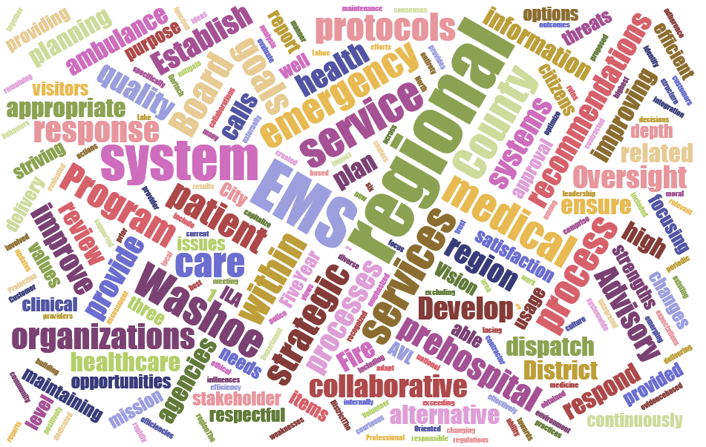
Questions?

